Slide 1
Creating Custom Connectors for the Power Platform

Slide 2

About Me
Business Applications MVP
Maker of D365 Developer Tools
Blog: https://jlattimer.blogspot.com
GitHub: https://github.com/jlattimer
Twitter: @JLattimer
Jason Lattimer
Development Manager PowerObjects

Slide 3
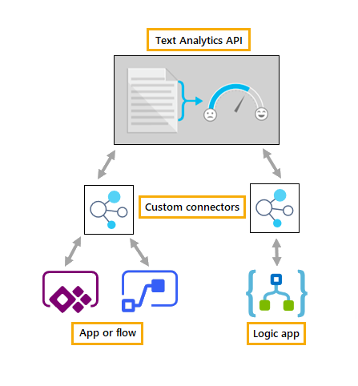
What Is A Custom Connector?
Way of connecting to a REST API
Publicly facing
Privately hosted (via data gateway)
Works with PowerApps, Flow, & Logic Apps
Allows you to connect to APIs that don’t have OOB connectors
Existing APIs
APIs created by you

Slide 4
Custom Connector Considerations
Security / authorization
Supports: Generic OAuth, OAuth for specific services like AAD, Basic, & API key
API
Hosting costs (private)
Limiting access (private)
Consumption costs (public)
Performance (public & private)
Platform limitations
500 requests / minute per connector
Logic App: 1,000 connectors
PowerApps or Flow (free): 1 connector & no sharing
PowerApps or Flow (Plan 1 or 2): unlimited connectors

Slide 5
Getting Started
REST API (Logic Apps can use SOAP)
OpenAPI definition (file or URL) or
Postman collection or
Knowledge of the API functionality
Helpful to have knowledge of:
HTTP requests & responses (GET, POST, DELETE, etc.)
JSON data

Slide 6
Open API Specifications
Describes an API
Endpoints
Operations (GET /users, POST /users, etc.)
Input & output parameters
Authentication methods
Contact into, license, terms of use, etc.
Also known an ‘Swagger’

Slide 7
Demo: Open Movie Database Search

Slide 8
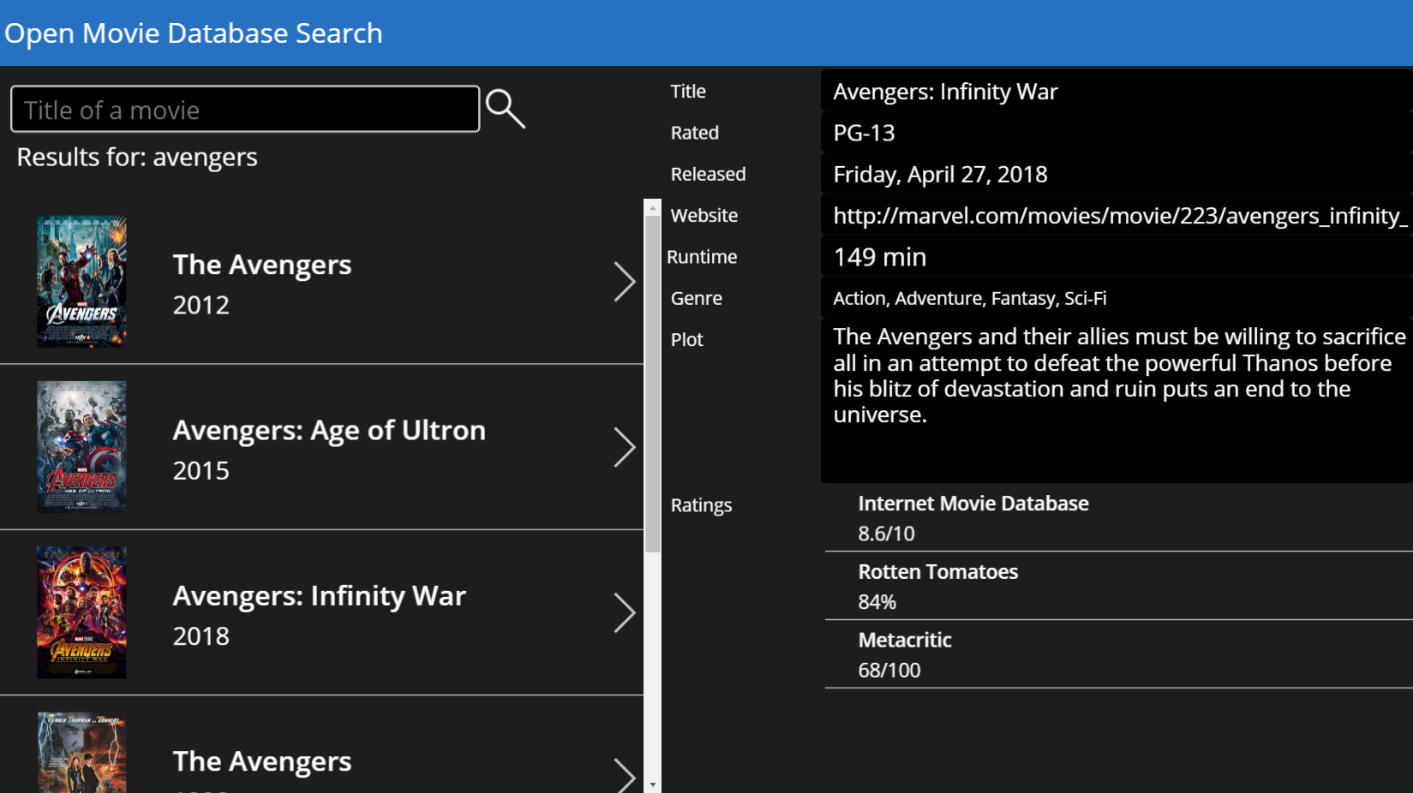
Open Movie Database Search
www.omdbapi.com
Register for API Key
GET based

Slide 9
Deployment
Sharing PowerApps also shares custom connectors
Users will need to authenticate
OAuth log in
Basic username/password or API key
Deleting a shared connector will break everything using it
Exporting app doesn’t directly include connections
Setting up Azure Active Directory authentication is confusing
No way to distribute credentials or API key with connection

Slide 10
Developing

Slide 11
Good Open API Definitions
Accept & return classes with descriptive property names
Straightforward (but not long) operation names
Visibility (operations & parameters)
Important - always shown to the user first.
Advanced - hidden under an additional menu
Internal - hidden from the user
Requirement level & correct data types prevent errors
Static & dynamic lists – limit to predefined values

Slide 12
Azure Functions
Handle Microsoft specific extended Open API definitions
https://github.com/wobba/AzureFunction-SwaggerDefinition
https://github.com/jlattimer/AzureFunction-SwaggerDefinition
Decorate methods & properties
Adds new “Swagger” function that returns the Open API definition
Azure Portal -> Platform Features - > API Definition is just a template

Slide 13
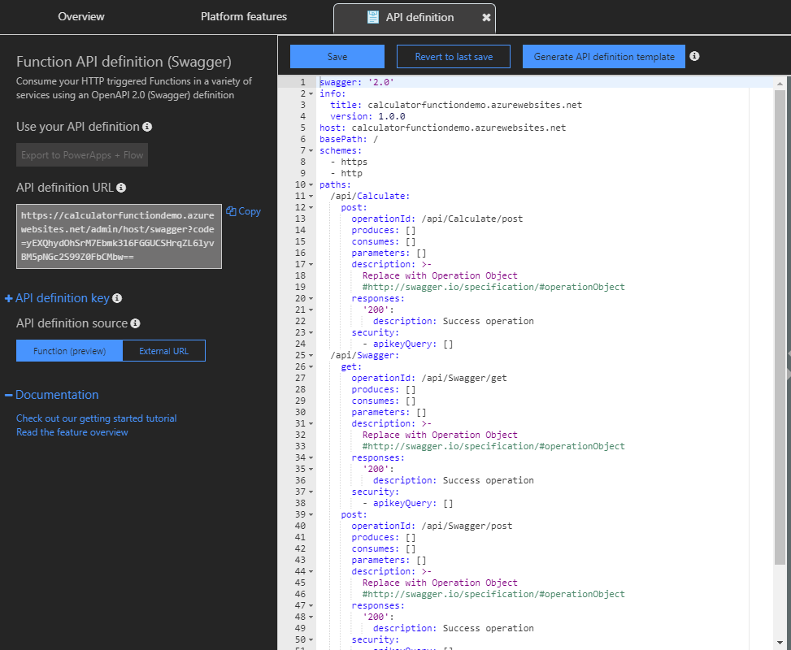
Azure Functions

Slide 14
.NET Web API
Handle Microsoft specific extended Open API definitions
https://github.com/BenasJacikas/swashbuckle-flow-extension-core
https://github.com/jlattimer/swashbuckle-flow-extension-core
Decorate methods & properties
Updates the existing Open API definition returned

Slide 15
Tips
Use parameters marked as Internal with predefined values
Static parameters required by the API that shouldn’t be changed
API keys
Can parameterize values after the base URL
https://www.myapi.com/api/product/{productid}
Return a friendly error message

Slide 16
Gotchas
Cannot parameterize base URLs
https://{subdomain}.myapi.com/products
Creating new connections sometimes won’t work for 30 minutes
Possible slow responses from Functions on Consumption plans
Modification often requires recreating or reimporting

Slide 17
Resources / Questions?
Everything you need to know about Open API
https://swagger.io/docs/specification/about
Custom connectors overview
https://docs.microsoft.com/en-us/connectors/custom-connectors/index
Extend an OpenAPI definition
https://docs.microsoft.com/en-us/connectors/custom-connectors/openapi-extensions
Presentation / Code
https://github.com/jlattimer/Presentations

